Slide 1
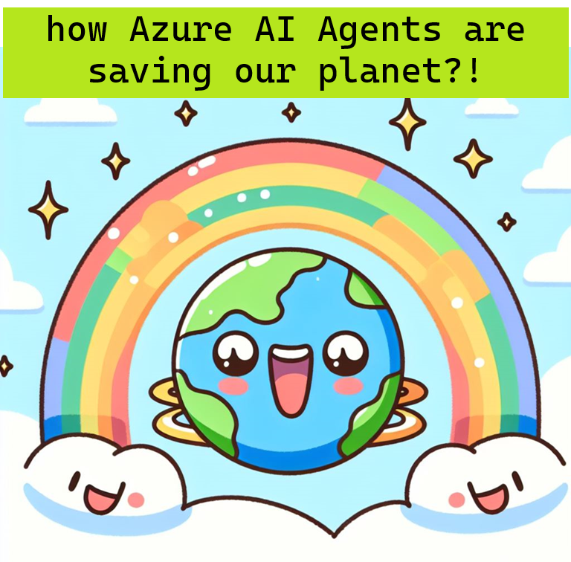
Earth Day Celebration! (4/22)
AI for Sustainability
How to measure carbon in software and how AI Agents enable developers to be carbon aware. Learning Objective: - What is green software. - Multi Agent Design Patterns/Frameworks - Demo of building an application with GHCP Agent Mode. - Demo of multi-agent implementation with Semantic Kernel and Azure AI Foundry. - Q&A Presented by Tammy McClellan,
Cloud Solution Architect Microsoft
Notes:
Oxy moran

Slide 2

My personal journey with sustainability
Notes:
I thought I would take you on a journey

Slide 3



Which evolved to
Sequestering carbon in soil.

Slide 4


Making sustainability a part of my job. Green Software Foundation | GSF

Slide 5

What is Green Software?
Green Software is software that is responsible for emitting fewer greenhouse gases. Our focus is reduction, not neutralization.

Slide 6
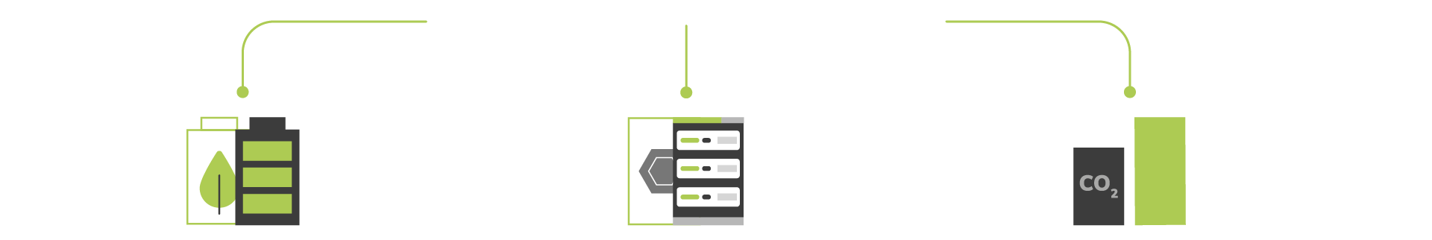
What makes software green?
Green Software
Emit the least amount of carbon possible
Energy Efficiency Consume the least amount
of electricity possible
Hardware Efficiency Use the least amount of
embodied carbon possible
Carbon Awareness Do more when the electricity is clean and less when it’s dirty
The processes, methodologies and tools that go into the area of Green Software is called the field of Sustainable Software Engineering.
Notes:
Green software is software that emits the least carbon possible. There are three ways to reduce the carbon emissions of software: through energy efficiency, carbon awareness, and hardware efficiency.
Energy efficiency means your software is consuming the least amount of electricity possible.
Hardware efficiency is using the least amount of embodied carbon as possible.
And carbon awareness means adjusting your workflow so that you’re doing more when you’re using clean electricity and doing less when it’s dirty.

Slide 7
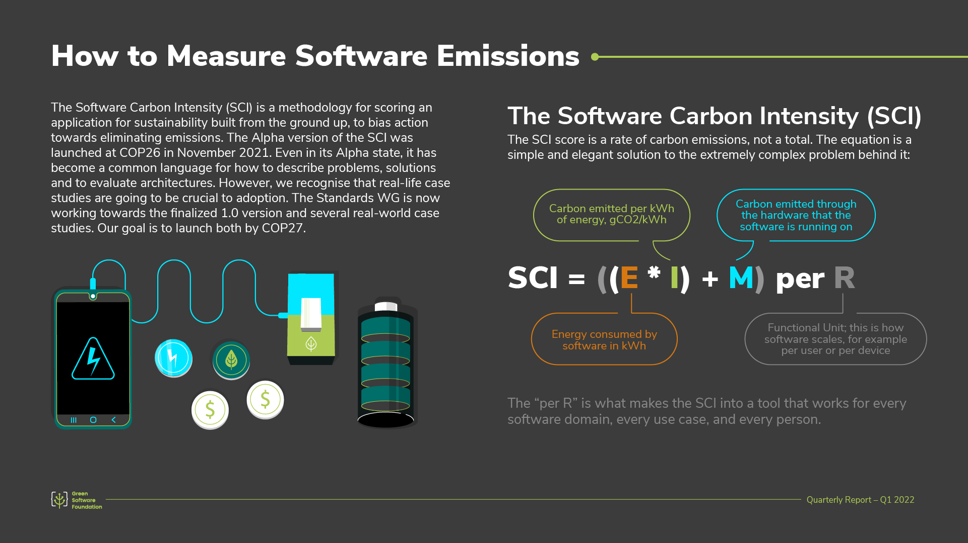
Notes:
One of the most promising projects is the SCI framework.
In a nutshell, it’s a specification for coming up with a scoring system for software applications
You can see how that is calculated on the right side of the screen, however, it’s still a work in progress as we speak

Slide 8
How can we enable developers to be carbon aware using agents?
Calculate carbon for their software solution.

Slide 9

Multi Agent Patterns
Notes:
We have looked at single agent patterns for this solution too.

Slide 10
What is an Agent?
"System that uses a LLM to decide the control flow of an application."​
Simple
Fully
Step n
… Step 2
Step 1
Step 2
End
Autonomy Levels:
No Autonomy: Traditional RAG
Simple: Paths routing
Fully: Multi-step reasoning & acting
Architectures:
Single agent
Multi agent
LLM
Start
Step 1
Start
End
Step 3
End
LLM
Reasoning
Less
LLM Control
More
Notes:
LLM routing – decides between multiple paths.
Fully automated – loops taking 1 or more steps iterating.
Single agent with a narrow scope and limited number of constraints. Multi grows in space and complexity, each have their own area to focus on.

Slide 11
Agent Abstractions - Agent First-Class Citizen
Memory
Agent
Agent as high-level abstraction
LLM (gpt4-o, o1 etc.)
Persona (system prompt)
Tools (function code calls)
Tool - 1
gpt4-o
Tool - 2
Persona
Tool - n
Agent 1
Agent Chat as layer for collaboration
Multiple agents can engage with each other
Enables multi-turn or parallel execution
Agent 2
CHAT
Agent 3
Notes:
Semantic Kernel promotes the agent as a first class citizen. To make a agentic solution – pick the model with reasoning models – gpt 4o or newer. Needs to be supported by your SDK. Give Persona (system prompt) and tools.

Slide 12
Agentic Pattern - Tools Calling
LLM Model
What electronics do you
have between $10 and $50
{ tool_name: ‘product_search’
tool_args :
{
min_price : 10 ,
max_price: 50,
category: ‘electronics’
}
Tool Invocation
Request
Tool Calling
3
4
5
Users
2
Tool
Binding
App
AppCode.class
Search ( minPrice, maxPrice, category )
AppCode.class
@Tool( name =‘product_search‘, description =‘search for available products’ )
Search ( minPrice, maxPrice, category )
Tool Creation
1
6
Tool
Execution
Notes:
The key LLM capability is it enables the agents to reason and plan and conduct. SDK @Tool with metadata. Tool Binding allow the model to be aware of the tools, defined in the application. Executes piece of code and executes the response.

Slide 13
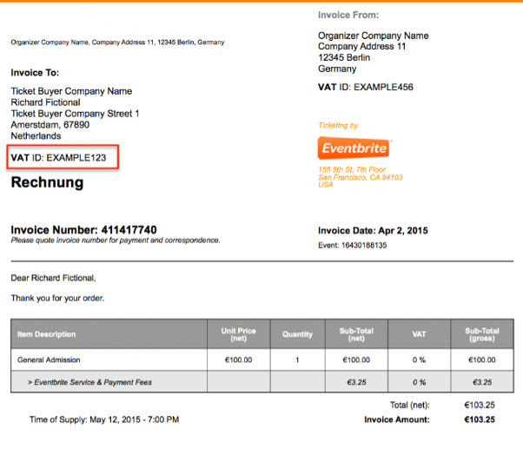
Agentic Pattern - ReAct Planning with Tools Calling
Payment Agent
while ( new tools execution request )
Pay this bill for me
Tools:
scanImage ( filename )
transactionHistory ( billId )
paymentService ( billId, Amount, Payee)
Users
scanImage ( bill-abc123.jpeg )
1
abc123, 100$, payeename
Instructions:
You are a home banking assistant allowing users to pay the bill uploading a picture
Always check if a bill has already been paid before submitting a payment
Confirm the payment result
Planning
2
transactionHistory ( abc123 )
bill-abc123.jpeg
no results
3
paymentService (abc123, 100$,payeename)
Bill abc123 successfully paid
ok
Notes:
Concept of React – allows the LLM to decide the sequence of steps – it reasons and acts. Decides which tool to call. Termination strategy. Human in the loop for confirming the amount to pay.

Slide 14
Agentic Pattern - Memory
Short Term
Access steps info in one loop iteration
Shared state context
Chat history
Long Term
Access steps info in long running conversation
State persistence
Conversation History Truncation
Trim by tokens
Trim by message count
Trim + summary (LLM call required)
First Chat Session
Second Chat Session
Chat App
Chat App
User
User
Write to memory store, scoped to user_id
Read from memory store, scoped to user_id
Memory Store
Memory Store
Notes:
Person may not be available to answer the questions – stores in memory. If flow is long – strategies to take, LLMs are getting bigger and larger context window. Helps to remove earlier conversation or limits on message count. Replace old messages with a summary.

Slide 15
Agentic Pattern- Flow control
Looping Termination
MaxIterations
Message termination
Human step /Human in the loop
Human in the loop
Action execution approval
Escalation
Data review
Payment Agent
Pay this bill for me
Tools Call Loop
Run 1
scanImage
Please approve payment
transactionService
Stop
User Review
Proceed
Tools Call Loop
Run 2
scanImage
transactionService
paymentService
Bill paid
Completed
Notes:
When do you want a human in the loop.

Slide 16
Multi Agent Logical Architecture
Agent 2
Tool - 1
gpt4-o
Tool - 2
Memory
Each agent is specialized in different tasks or aspects of a problem
Agents can communicate and coordinate with each other. Structured orchestration is crucial
2 primary categories based on orchestration types
Prompt
Tool - n
Agent 1
Orchestration
Memory
gpt4-o
Prompt
User
Agent 3
Tool - 1
gpt4-o
Tool - 2
Memory
Vertical Architecture
Horizontal Architecture
Prompt
Tool - n

Slide 17
Agents' orchestration and communication styles
Single Agent
Network
Reflection
Agent 1
worker
Tool - 1
gpt4-o
Tool - 2
Prompt
Tool - n
reviewer
Supervisor
Hierarchical
Custom
Notes:
Network – where agent can communicate with any other agent and each one can make the decision on who to call. Or all of them can be called in an ordered agent and you can loop through them until you receive a response.
Reflection: 2 or more agents, each one has a worker. Worker performs the task and the reviewer evaluates the worker output that can be used in the next iteration of worker loop. Improved output.
Supervisor: Each agent communicates with a single supervisor agent and decides which agent to call.
Hierachical: If a single supervisor is too complex you can have. Create teams of agents. Each team has it’s own supervisor.
Custom: Agents are called with custom workflow. Real complex scenario

Slide 18




Multi Agent Design The supervisor pattern
GOAL
Calculate carbon in software.
SCI Assistant(Coordinator)
- Decision-making
- Agent orchestration
Role: Coordinates entire system, calls resources as determined.
E
M
I
Personas(Tracking)
Responsible for responding to the Coordinator
- Area responsibility
Role: Relies on functions and grounded data to form
An opinion.

Slide 19
Agent frameworks and services
Semantic Kernel Agent Framework
Autogen
Langgraph
Azure AI Agent Service

Slide 20
Demo
tmcclell/AIforSustainability

